Slide 1
Team 2
Team Members
Tom Alex
Chetan Basnet
Krunal Bhavsar
Tom Cookson
Swayambhu Dhuri
Shubham Mittal
Suruchi Patil
Ruchi Sharma
Srija Reddy Sripathi
ParkEz

Slide 2
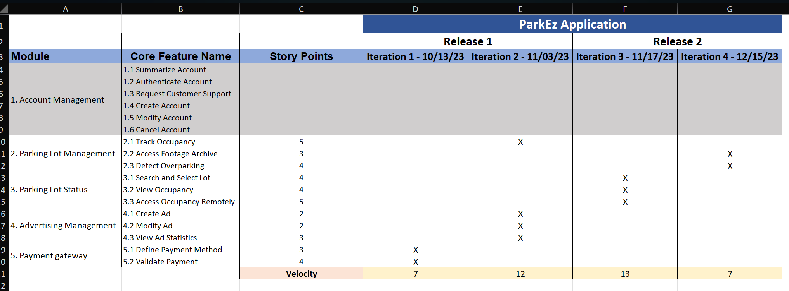
Presented by Tom Alex
Road Map (I3, I4)

Slide 3
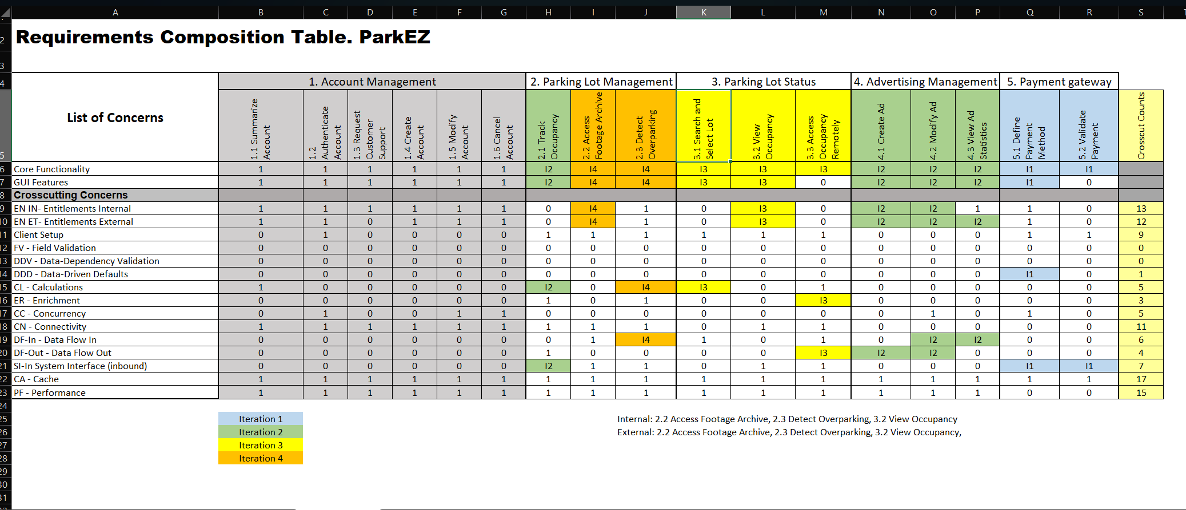
Presented by Shubham Mittal
RCT – Planning I3, I4

Slide 4
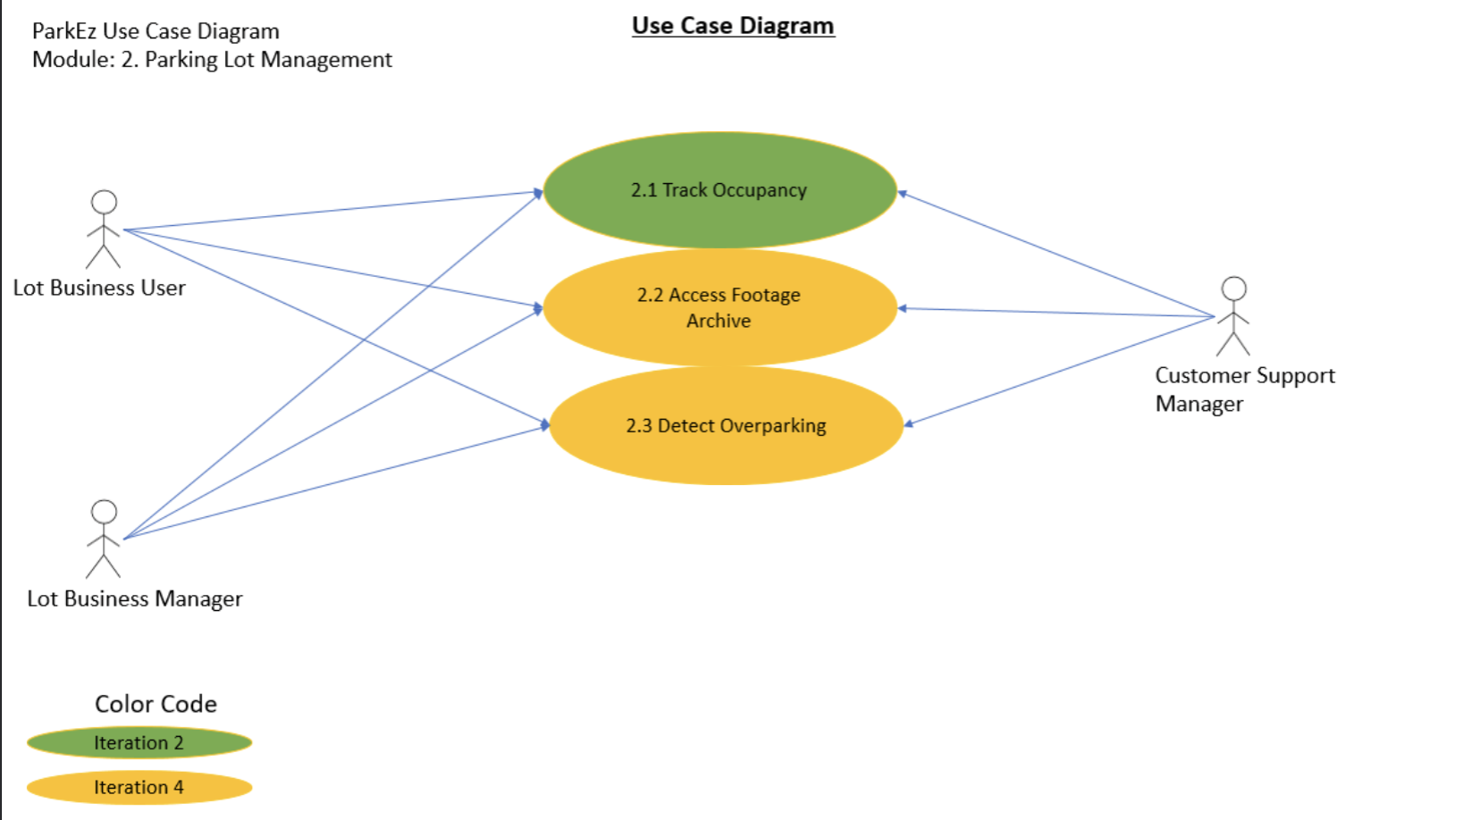
Presented by Chetan Basnet + Krunal Bhavsar
Use Case Diagrams (i3, i4)

Slide 5
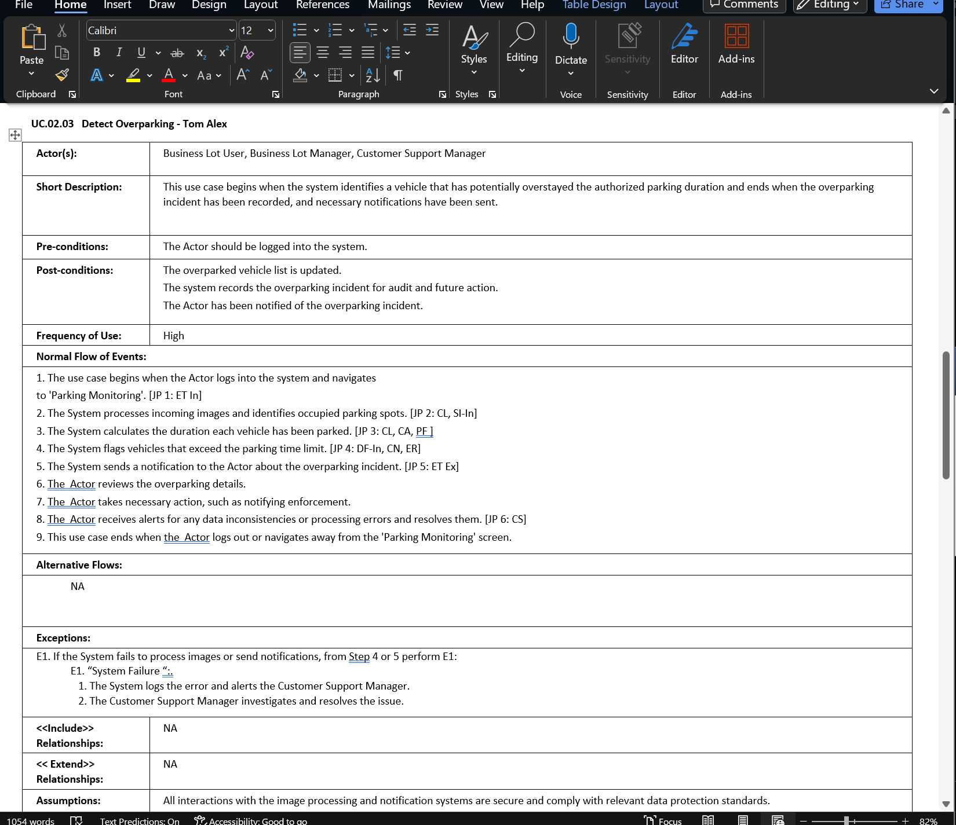
Presented by Suruchi Patil + Ruchi Sharma
Use Case Specs w/ JPs

Slide 6
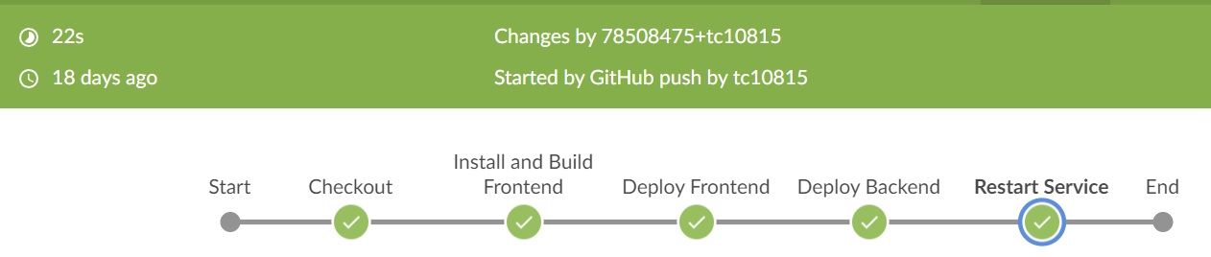
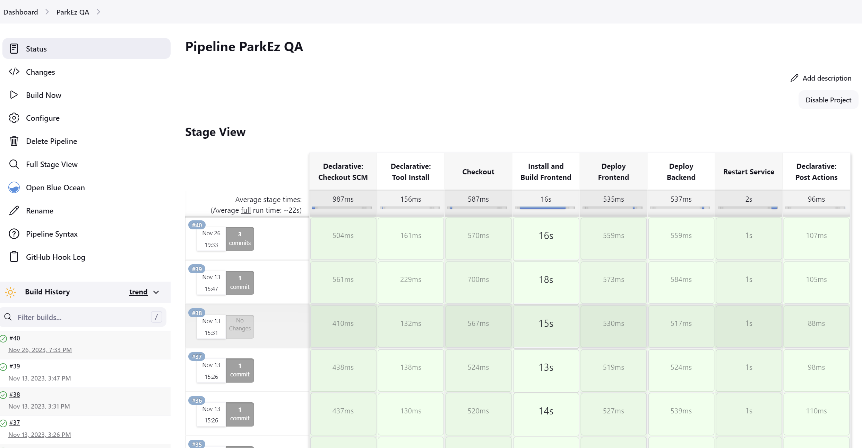
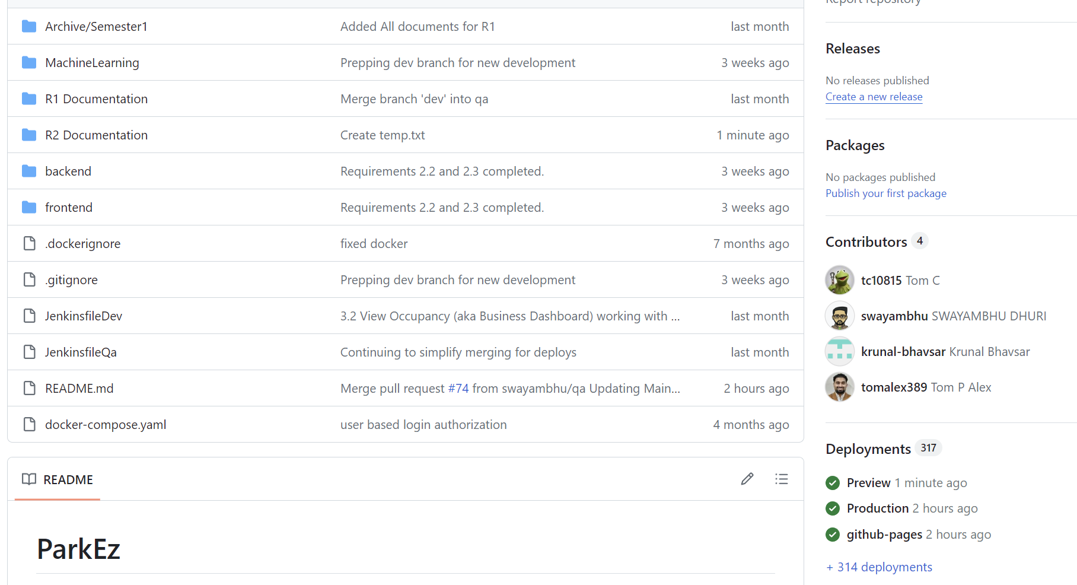
Presented by Swayambhu Dhuri
Source Code Sample and Deployment Log

Slide 7
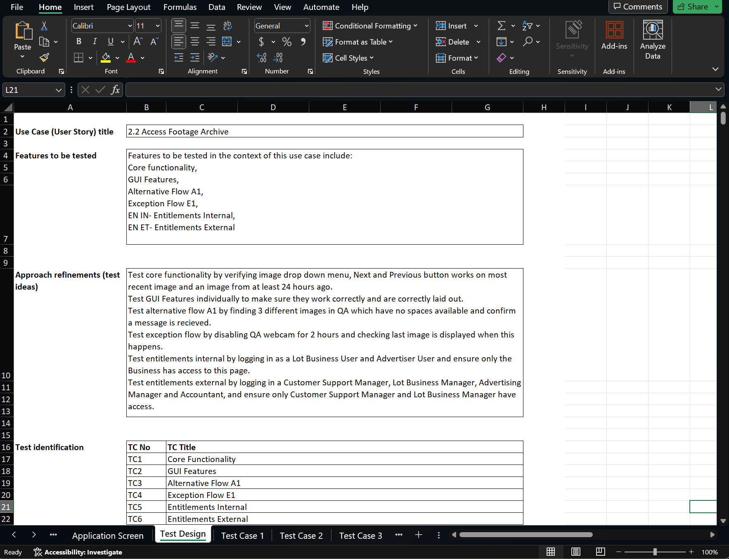
Presented by Tom Cookson
Functional Tests (I3, I4)

Slide 8
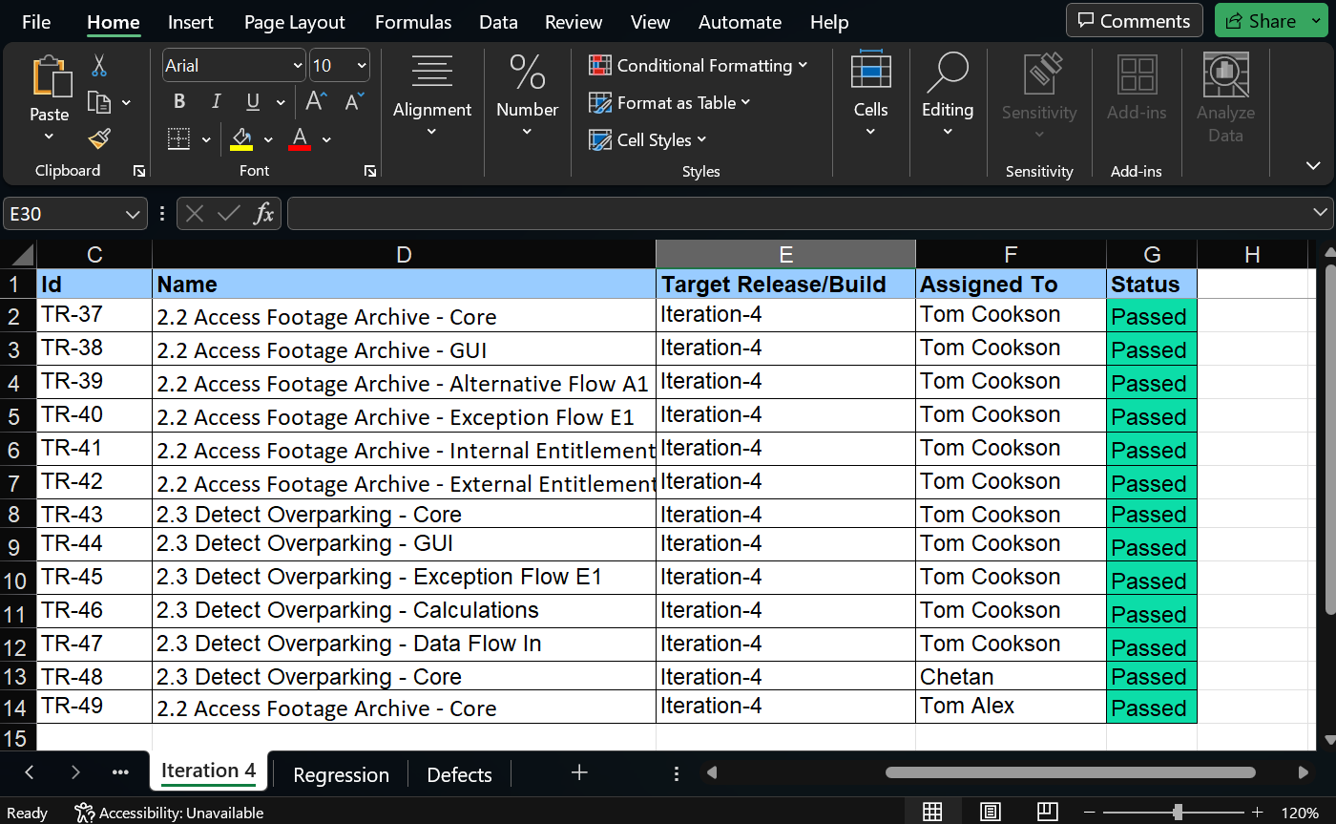
Presented by Tom Cookson
Test Execution Log

Slide 9
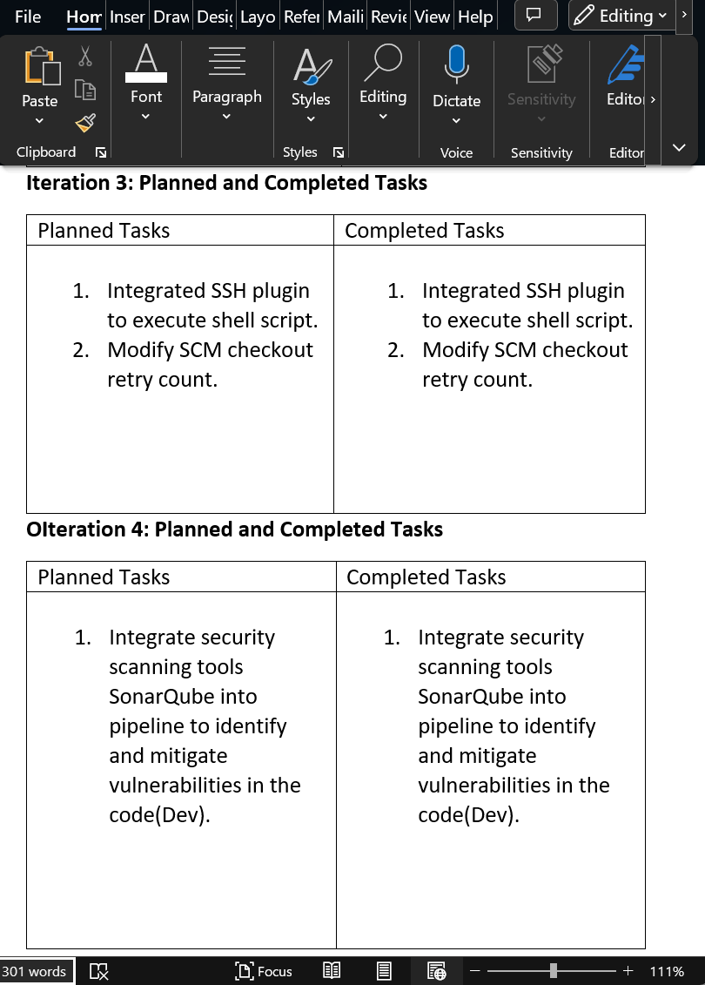
Presented by Srija Reddy Sripathi
Jenkins Progress Report

Slide 10

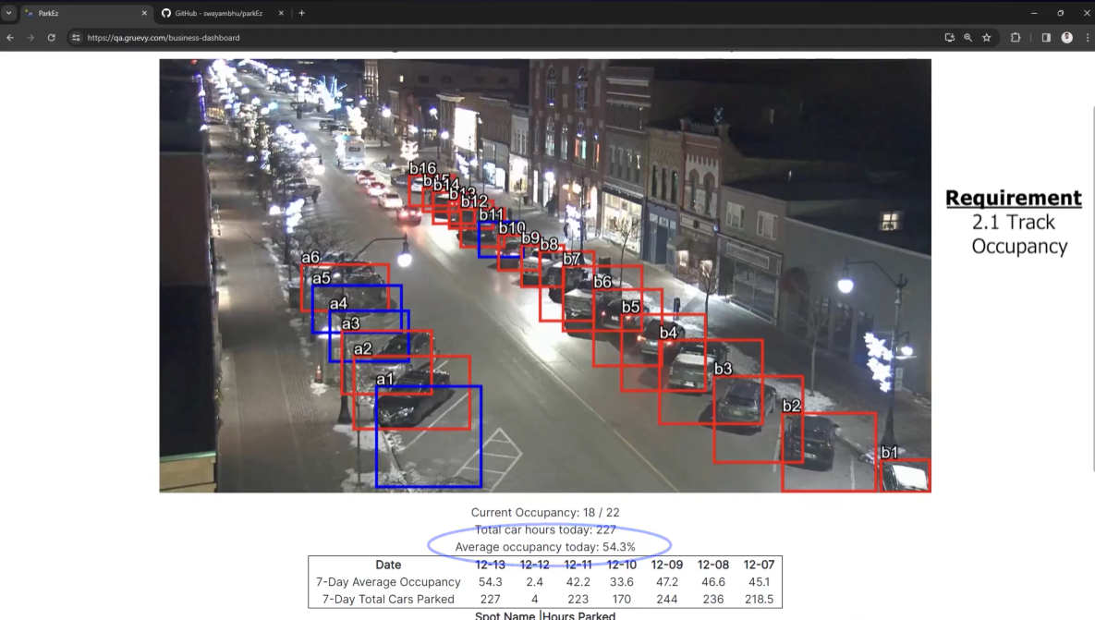
Presented by Tom Cookson
Application Demo
APPLICATION DEMO

